Slide 1
Student Roll Call by
Face Recognition
Samuel Kalunga
Nayana Pampapura Madali
Vaishnavi Garikipati

Slide 2
Objectives
The system enables instructors to take student roll calls in class using face recognitions
The instructor maintains all the information in the system and initiates roll calls
Students can view their respective attendance history

Slide 3
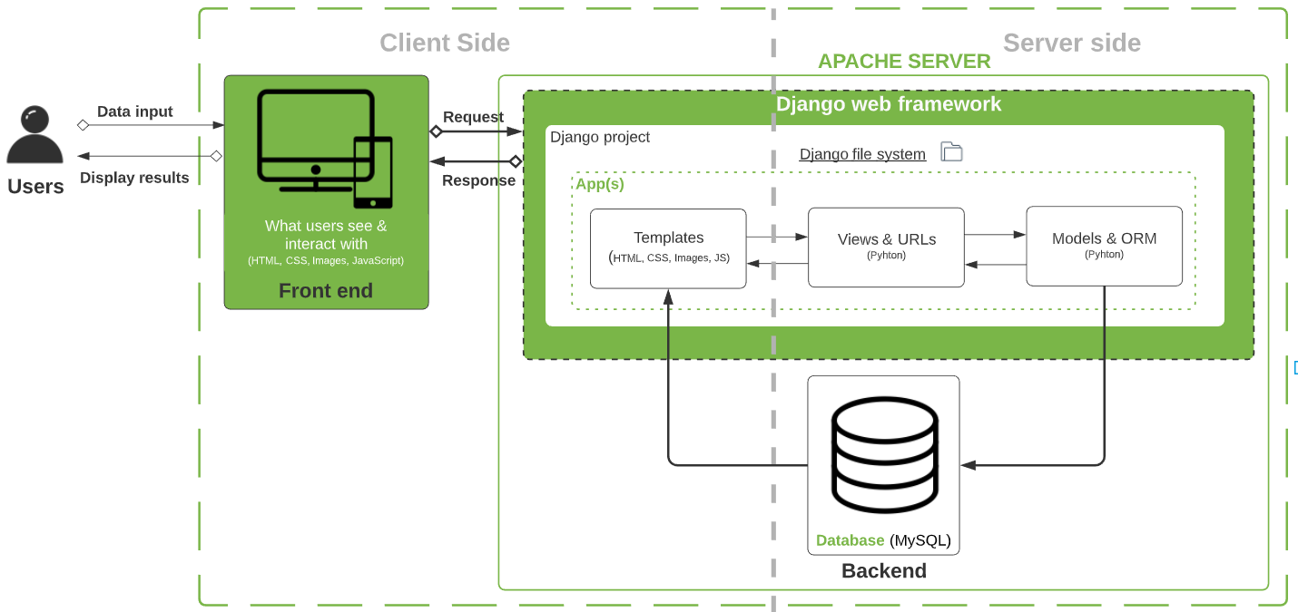
Overall architecture

Slide 4
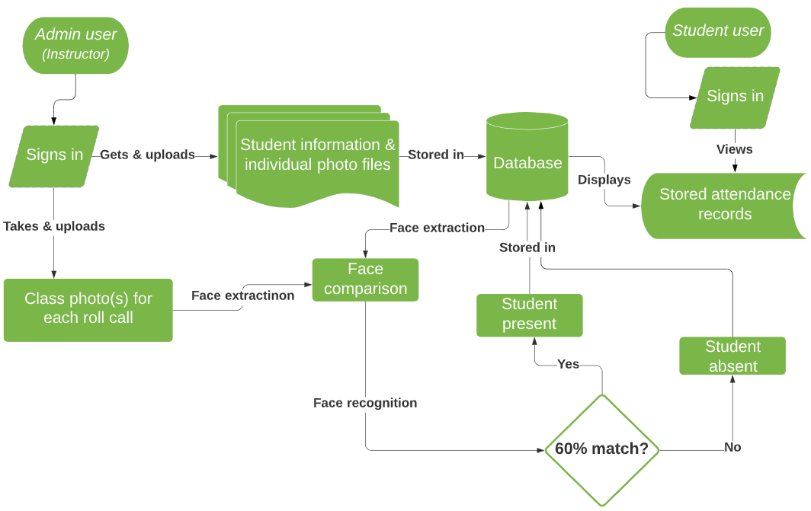
System Workflow

Slide 5
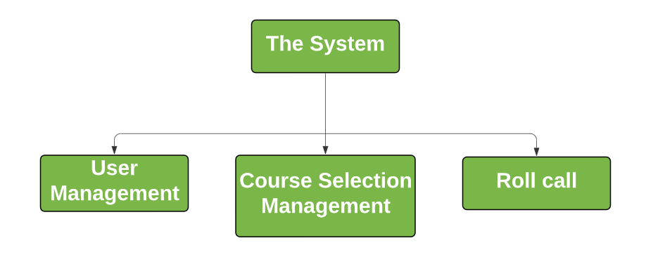
System Functions
The system consists of 3 modules:
User Management
Course Selection Management
Roll Call

Slide 6
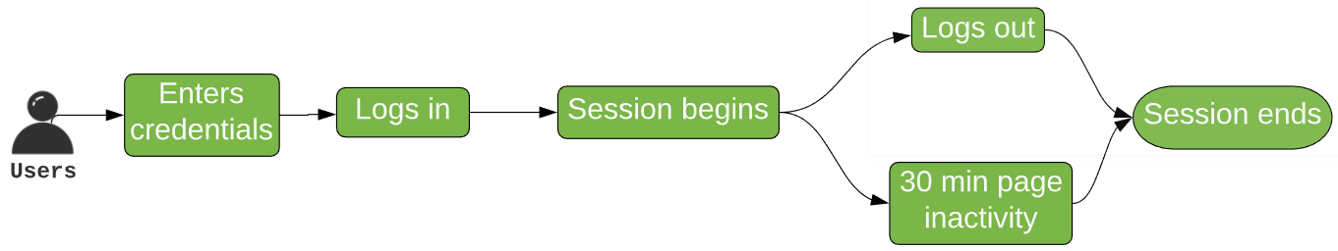
User Management
This module manages users’ login credentials and sessions
Those credentials are pairs of username (student ID) & password predefined in the system
There are 2 types of users: system administrator (instructor) & students
Sessions begin once users log in and end when they log out or sessions time out

Slide 7
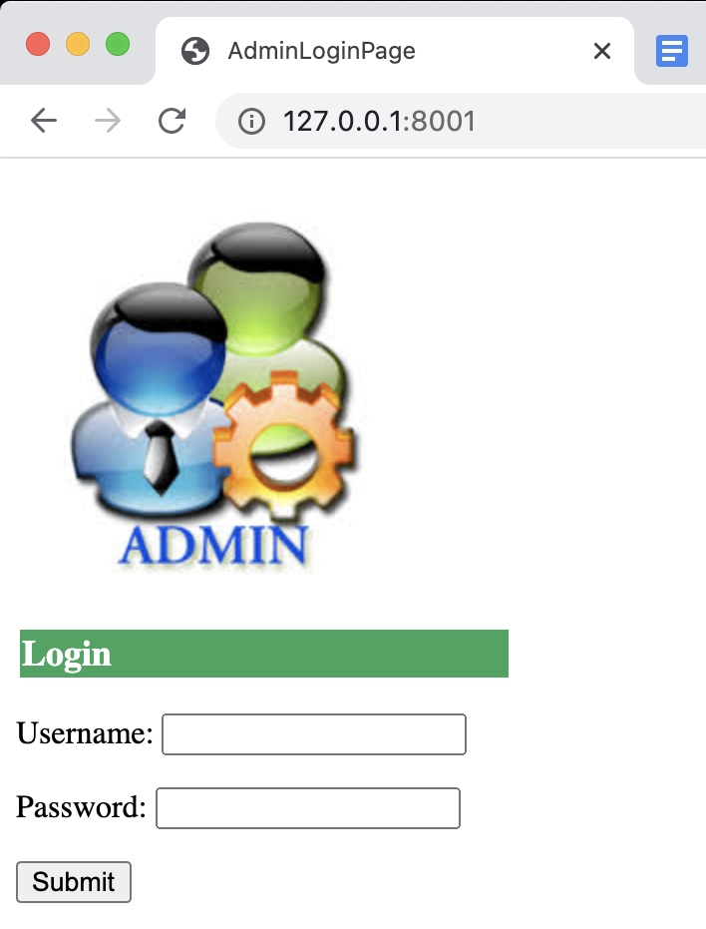
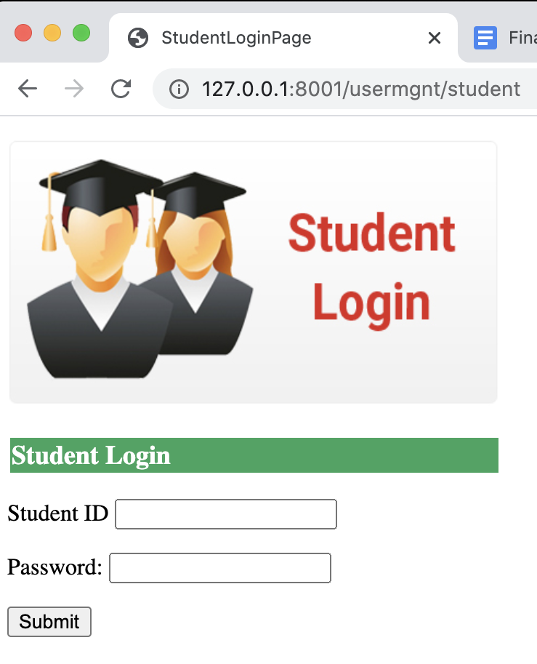
User Management
Administrator login page (the system home page)
Student login page (http address provided)

Slide 8
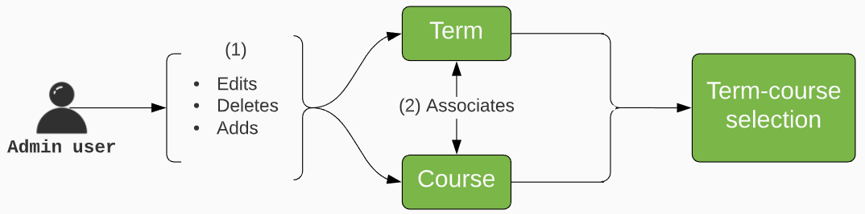
Select Course Management
This module has 3 kinds of information:
Term
Lists the terms available
Course
Lists all the courses
Course Selection
Is used to create association between a term and course

Slide 9
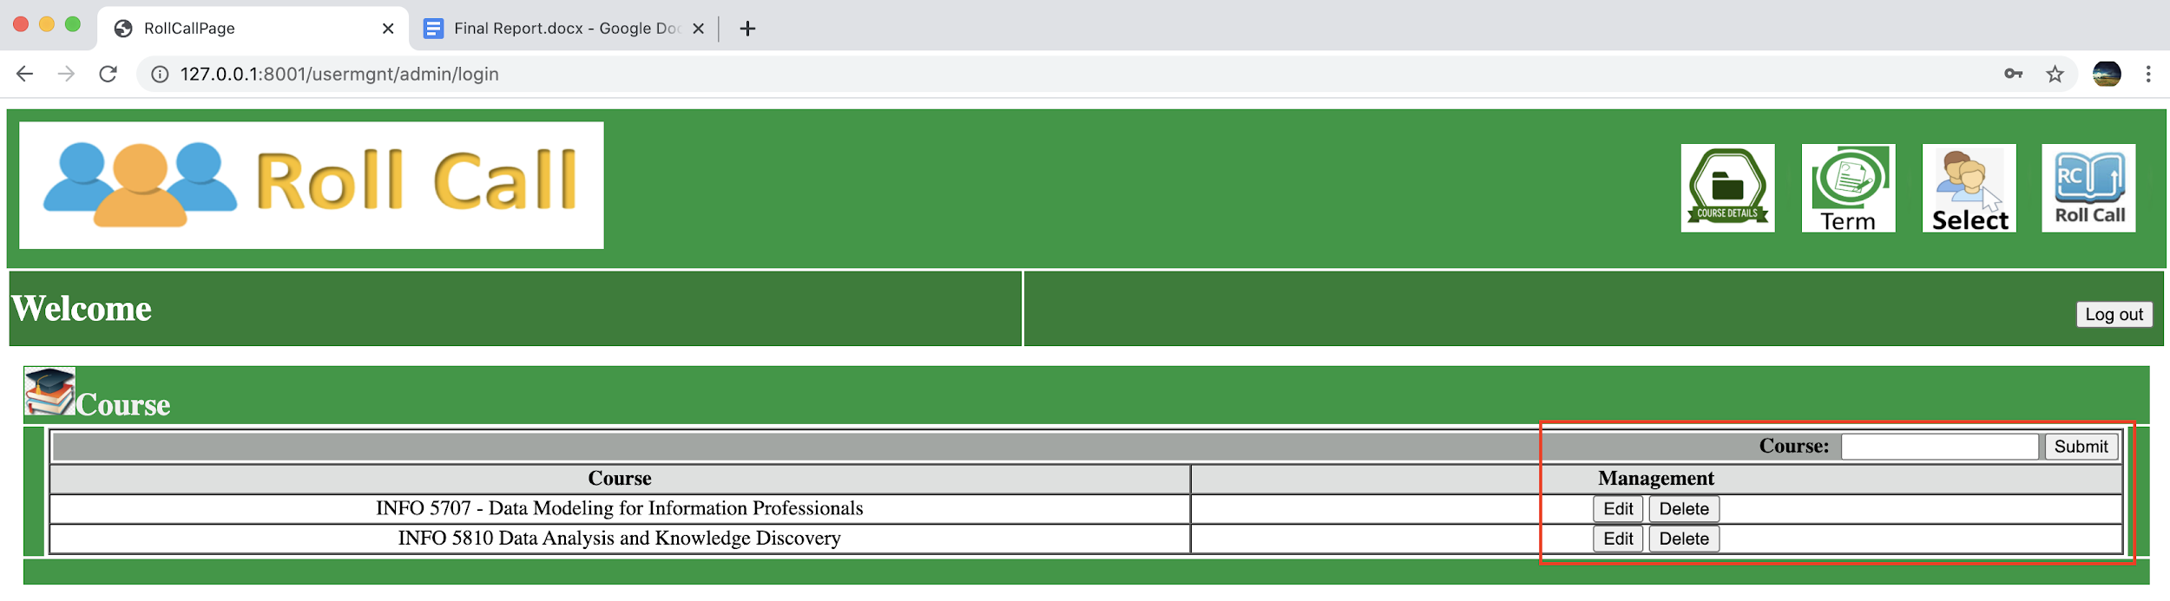
Select Course Management
Once logged in, the admin lands on the course page displaying a list of courses (the course icon leads back to this page)
The admin can then edit, add and/or delete courses as needed

Slide 10
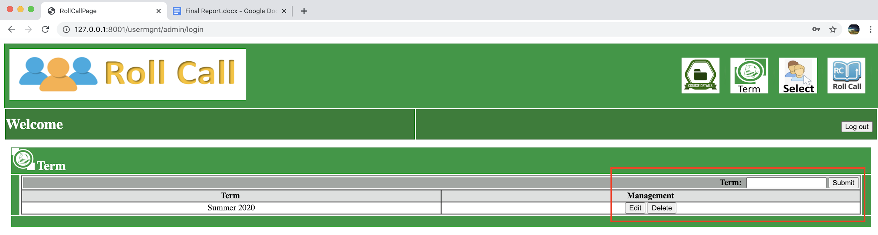
Select Course Management
The admin can then navigate to the term page displaying a list of terms
Here, the admin can also edit, add and/or delete terms as needed

Slide 11
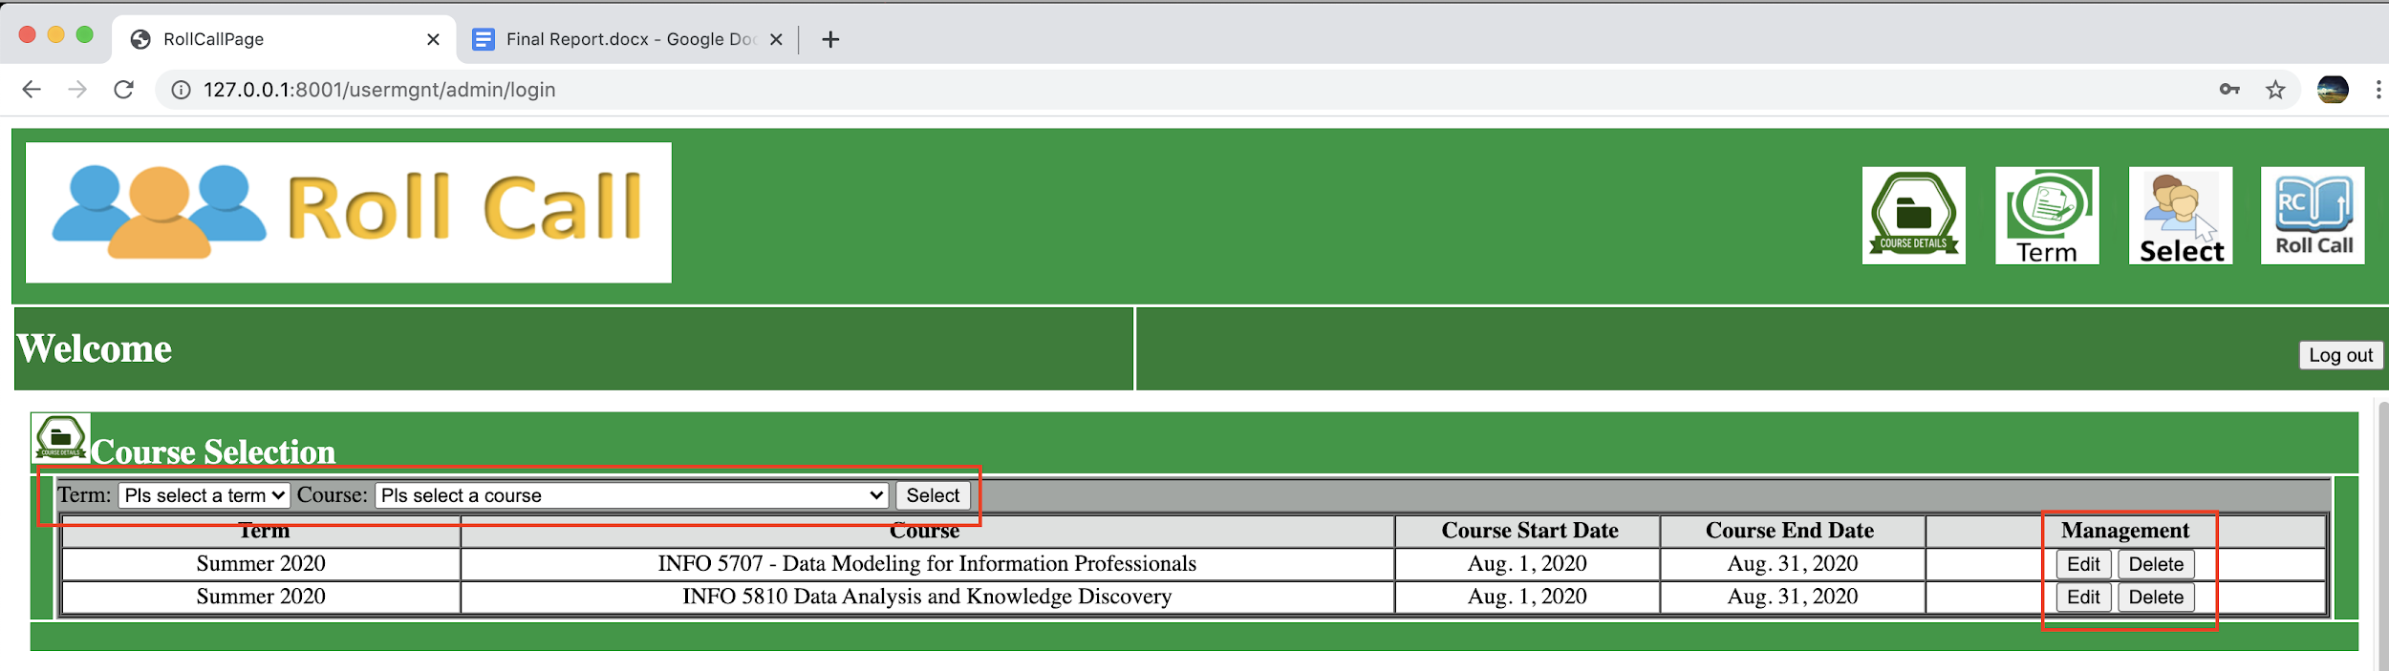
Select Course Management
After updating courses & terms, the admin navigates to the course selection page
The admin can then make associations between them as needed
Those associations can then be edited and/or deleted as needed

Slide 12
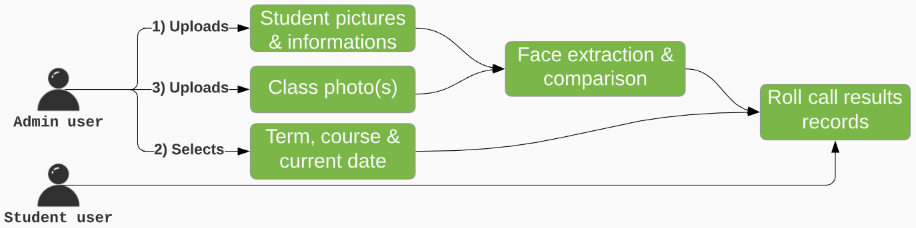
Roll Call
Roll Call functionality is carried out in this module.
The module handles the roll call operations and records.
The instructor sets up the necessary data and file for every roll call
Student users can access attendance records filtered by their respective student IDs which are the usernames they enter to log in

Slide 13
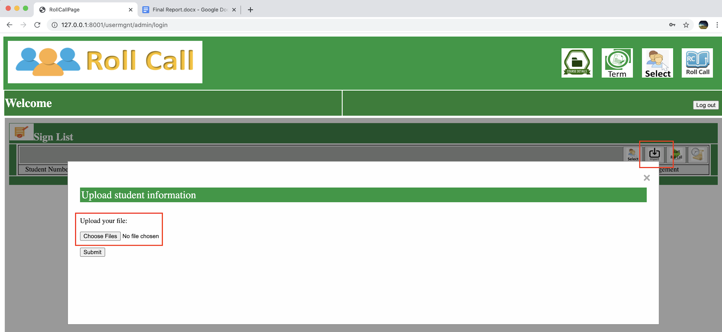
Roll Call
The admin then navigates to the roll call page displaying the sign-in list
Then clicking on the import icon opens up a widget
In that widget, the admin uploads student info files & pictures once

Slide 14
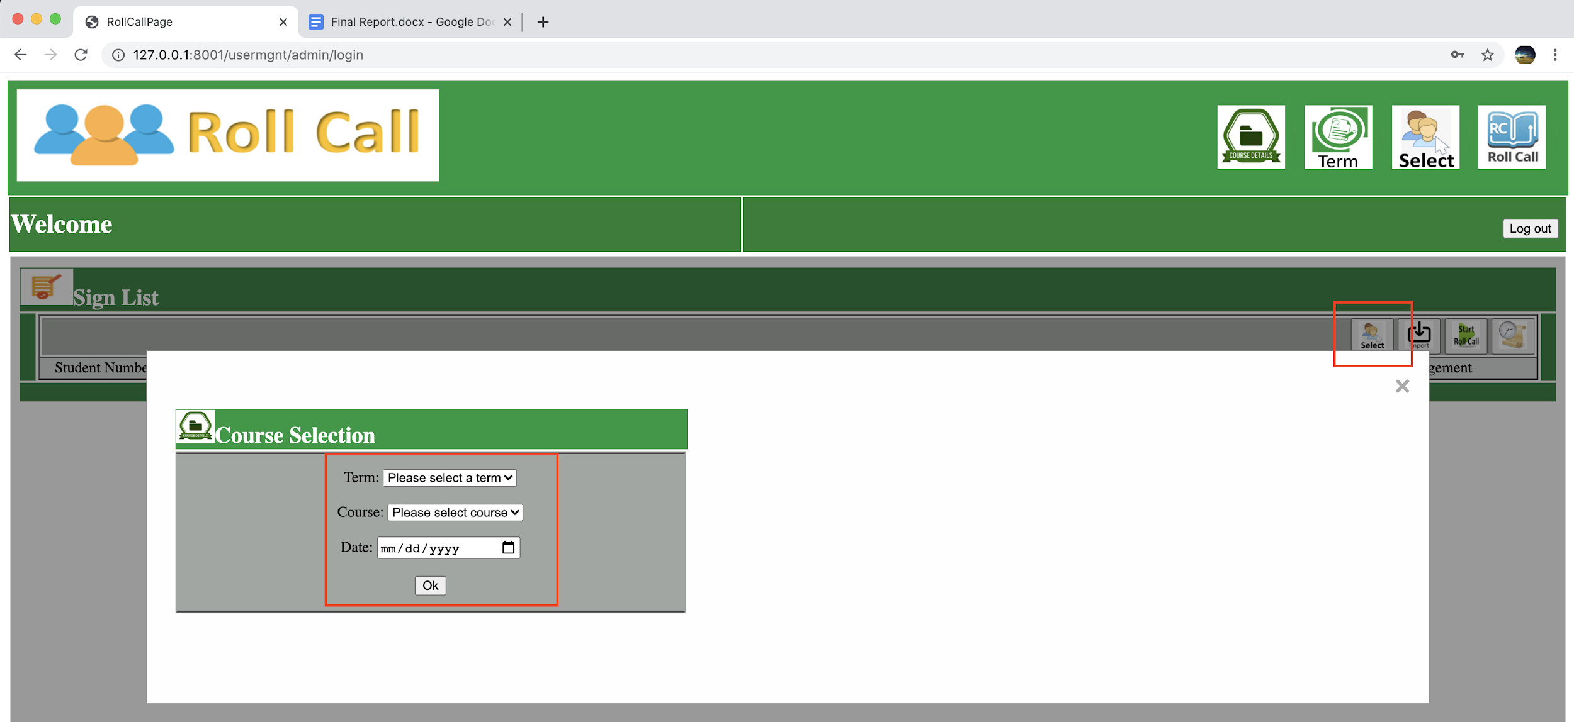
Roll Call
Still in the roll call page displaying the sign-in list
Clicking on the select icon opens up a widget
In that widget, the admin selects the roll call term, course and date

Slide 15
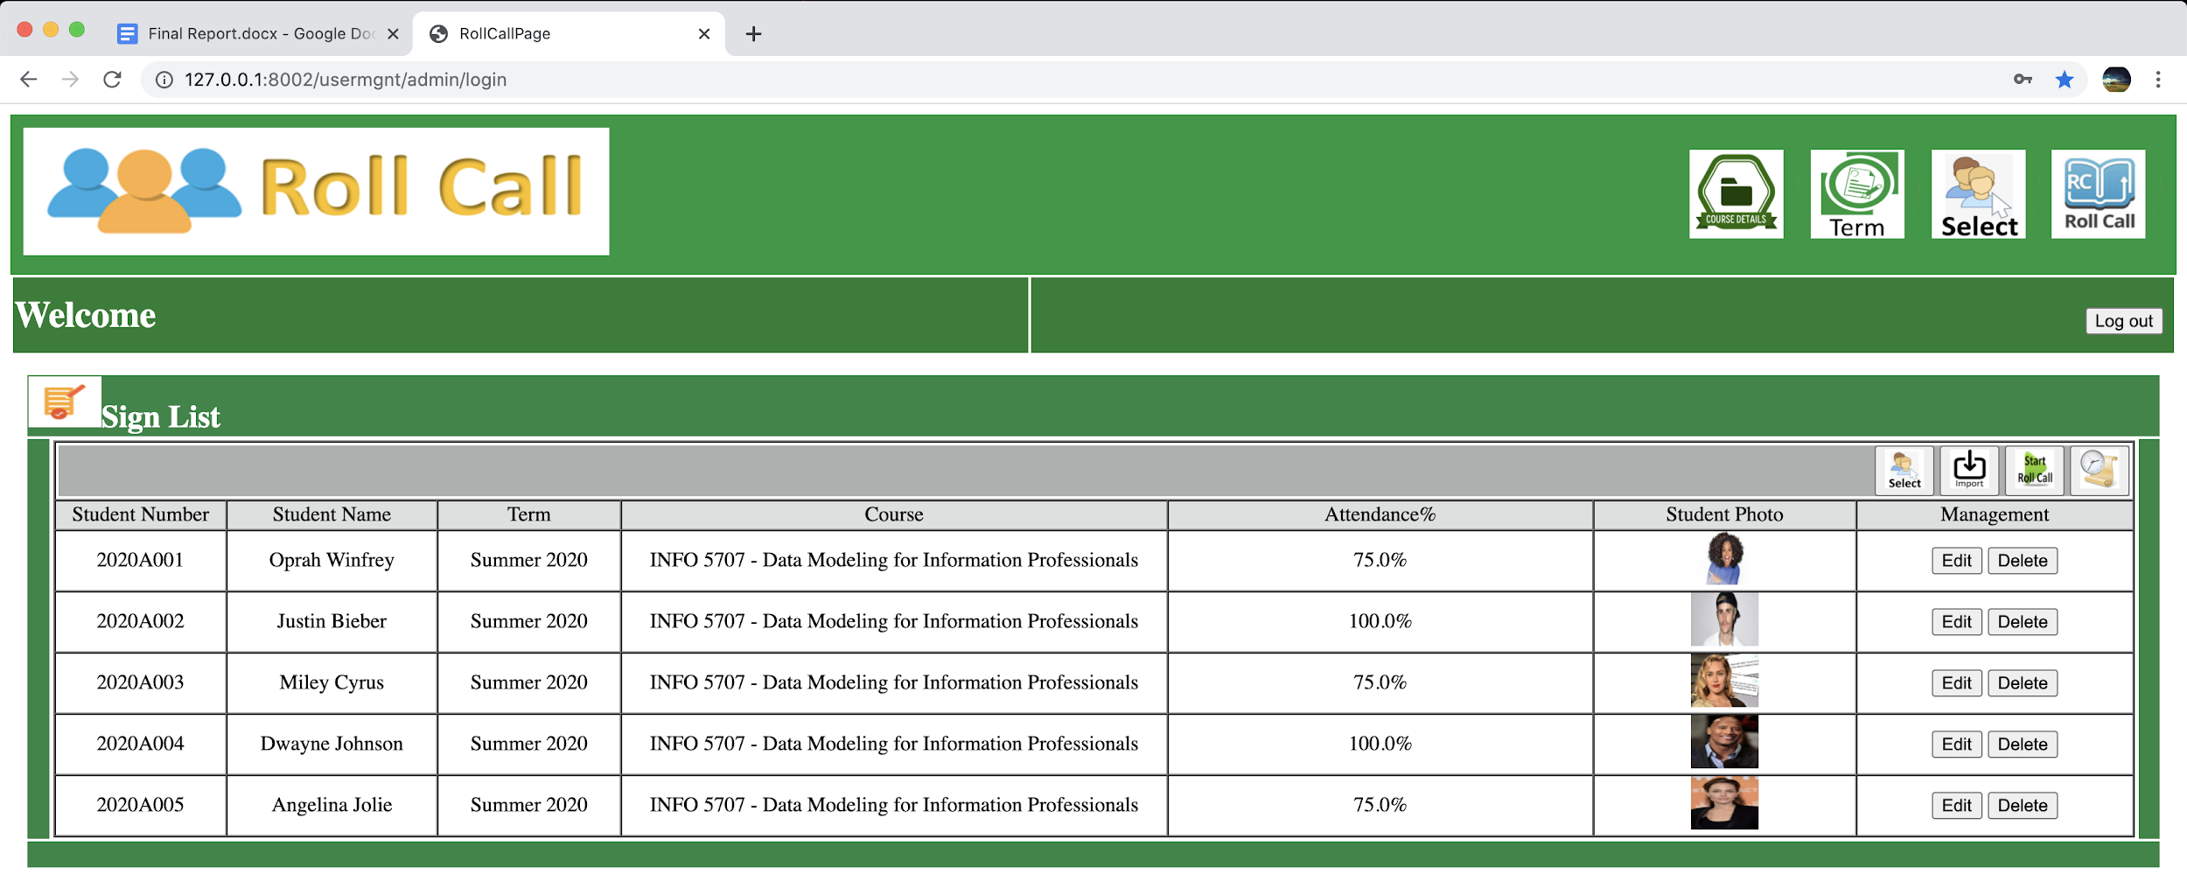
Roll Call
After refreshing the roll call page displaying the sign-in list
The page is then populated with the data the admin just uploaded and the roll call process may start for the term, course and date previously selected Note: Attendance% is 0 before the first roll call and will progressively adjust

Slide 16
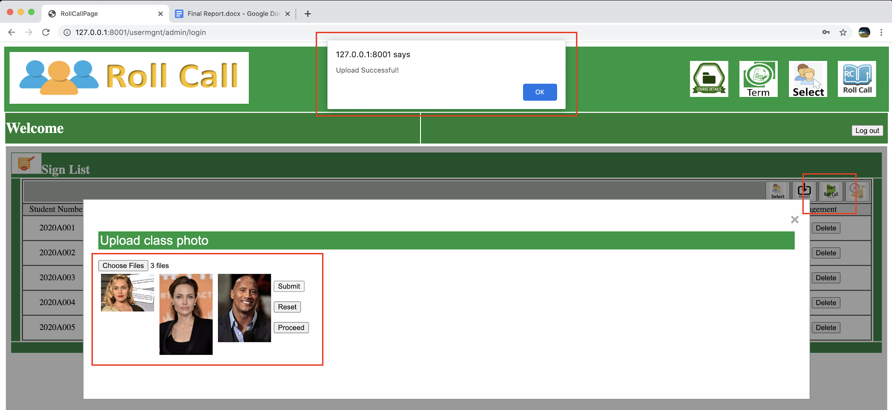
Roll Call
Continuing the roll call page displaying the sign-in list
Clicking on the start roll call icon opens up a widget
In that widget, after taking taking call class photo(s) as needed, the admin uploads them the clicks on the “proceed” button

Slide 17
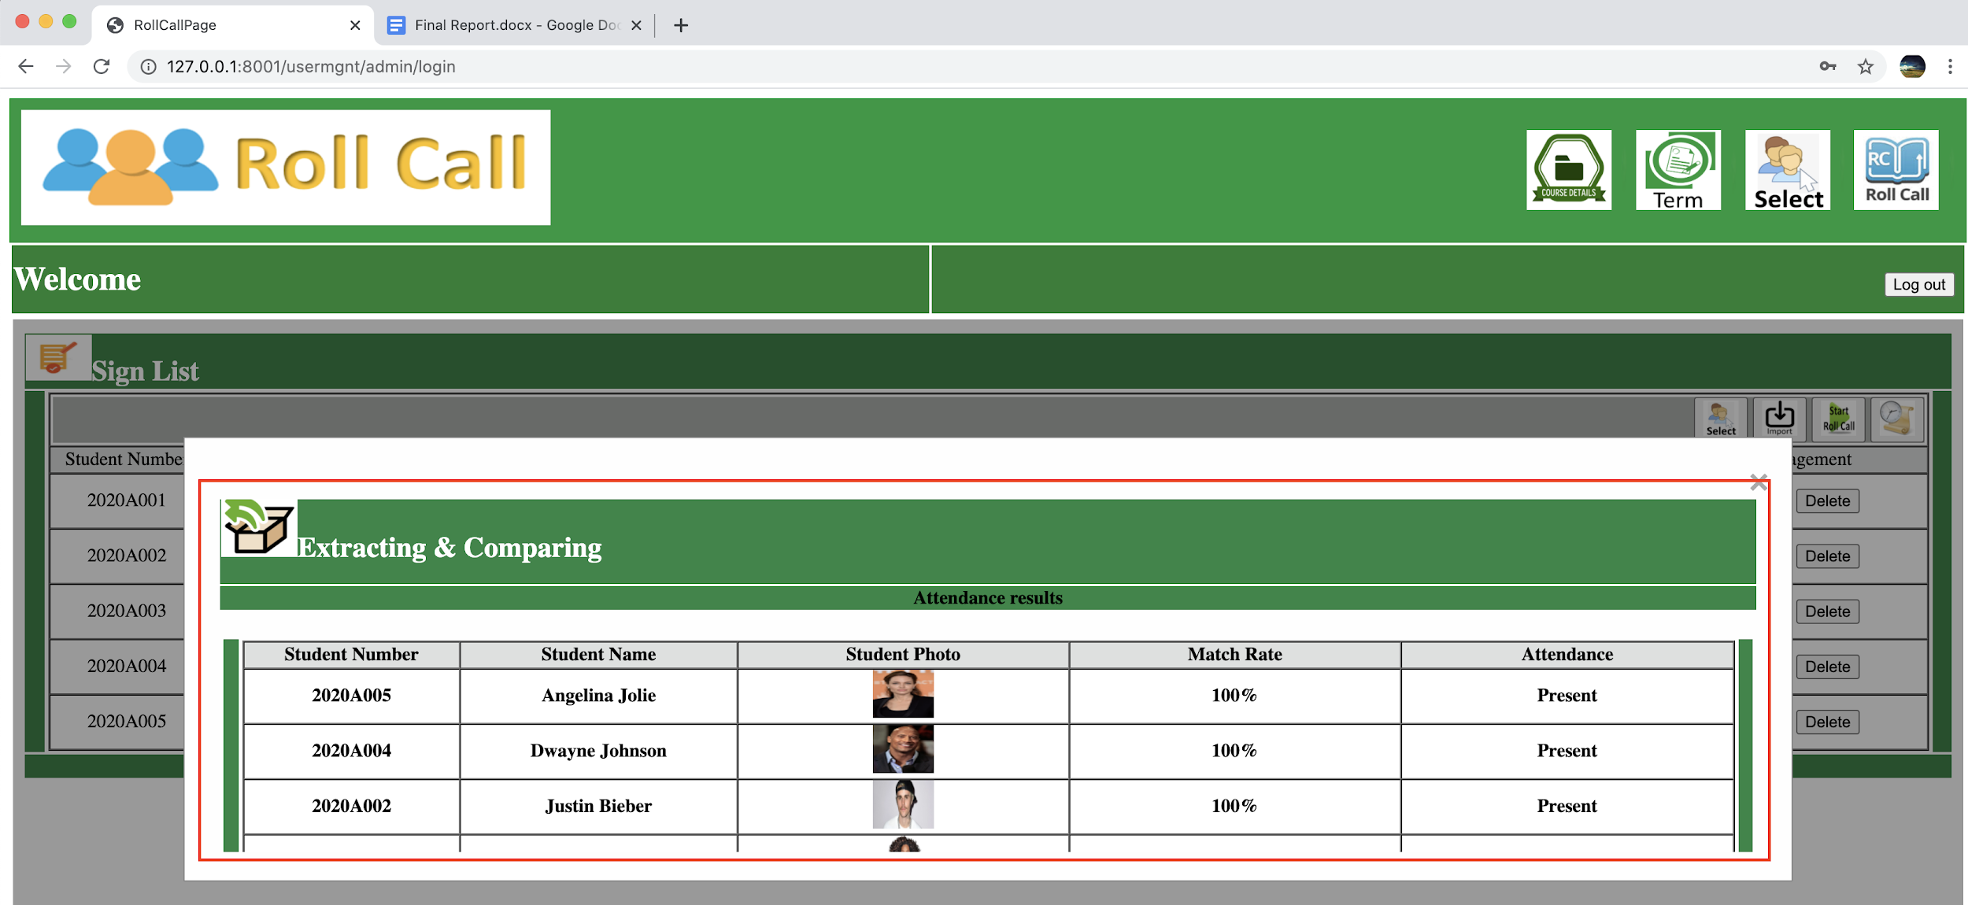
Roll Call
Continuing the roll call page displaying the sign-in list
Still in the start roll call widget, face recognition roll call results are displayed marking a student present for a face match rate of at least 60% and absent if any less than that number

Slide 18
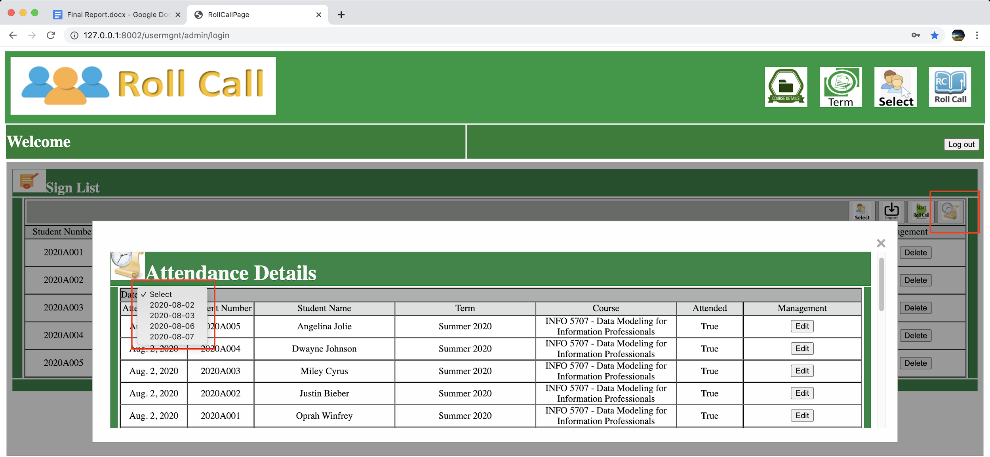
Roll Call
Continuing the roll call page displaying the sign-in list
Clicking on the history icon opens up a widget
In that widget, attendance history is listed for the course, term and date selected prior to performing the roll call and can be filtered by date or edited

Slide 19
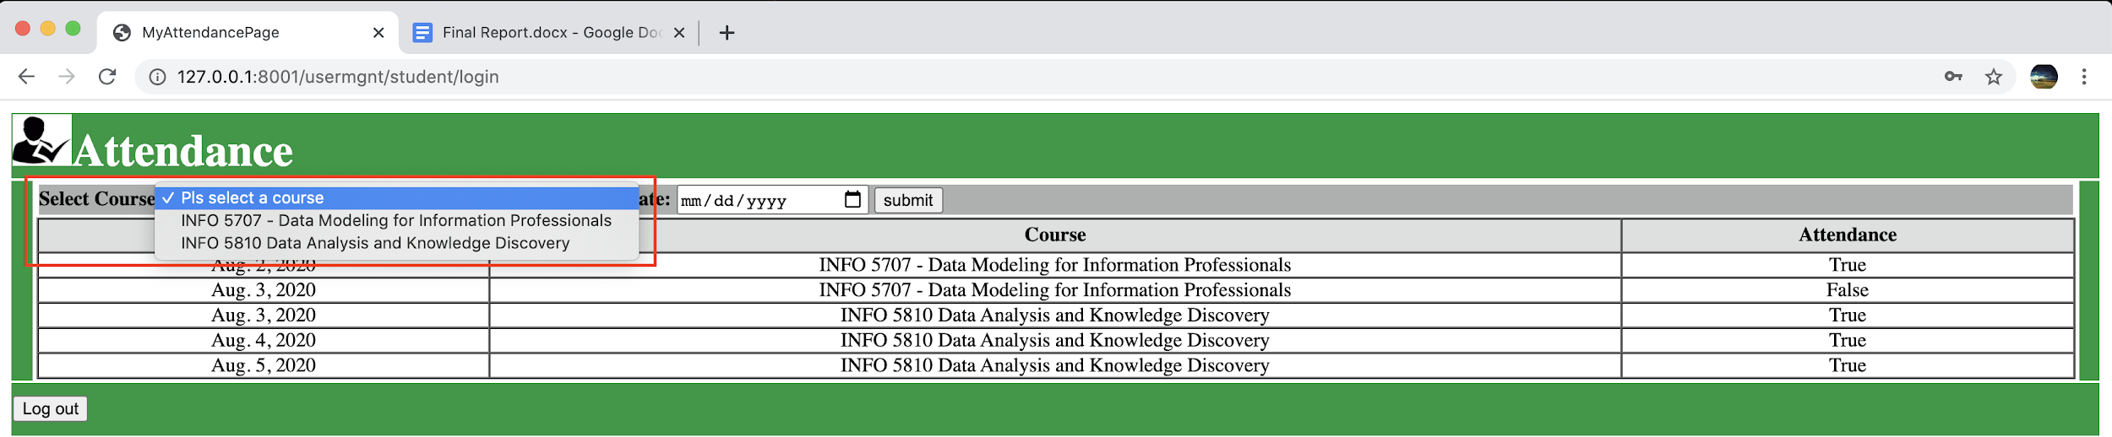
Roll Call
Once logged in, students access their individual attendance history page
Which they can filter by course, term and date

Slide 20
Roll Call
Students and admin each can log out of their pages by clicking the “Log out” button and be redirected to their login pages

Slide 21
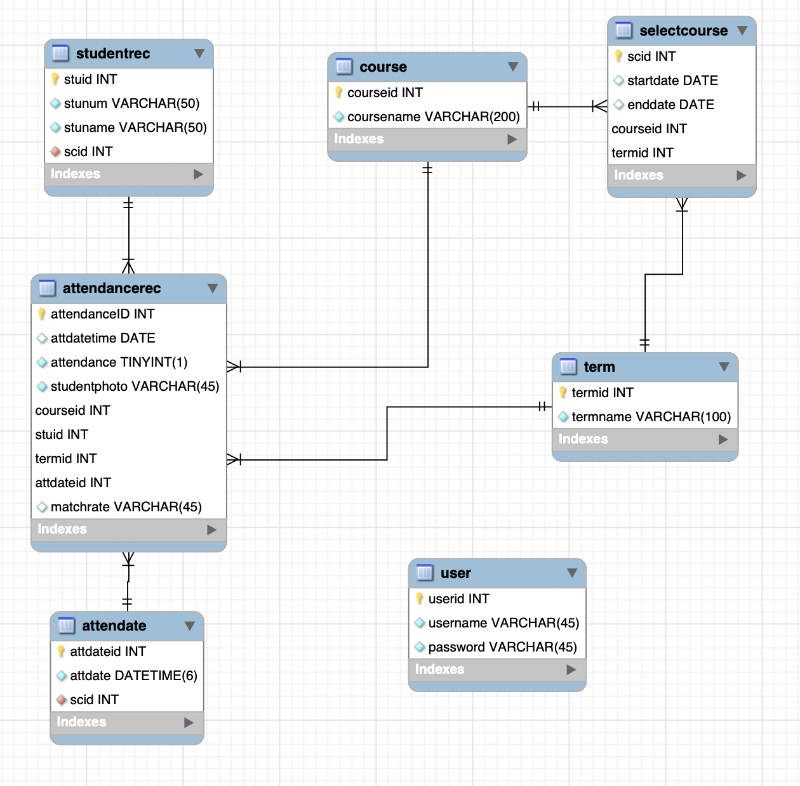
ER Diagram
Select Course Management module
Roll Call module
User Management module

Slide 22
Thank You!!

